Slide 1

World Wealth Data Analysis
BRIDGING ECONOMIC DISPARITIES
Prashant Rana
Manne Dharanidhar
Himagiri Bhawana Apisetty
Anjalipriya Rajulagiri
Team 9

Slide 2





MEET THE TEAM
Prashant Rana
Manne Dharanidhar
Himagiri Apisetty
Anjalipriya Rajulagiri
Project Manager
Data Engineer
Data Analyst
Data Scientist

Slide 3
PROBLEM STATEMENT
There’s a huge disparity in wealth of developed and undeveloped countries. Is it feasible to bridge the gap in wealth between them?

Slide 4
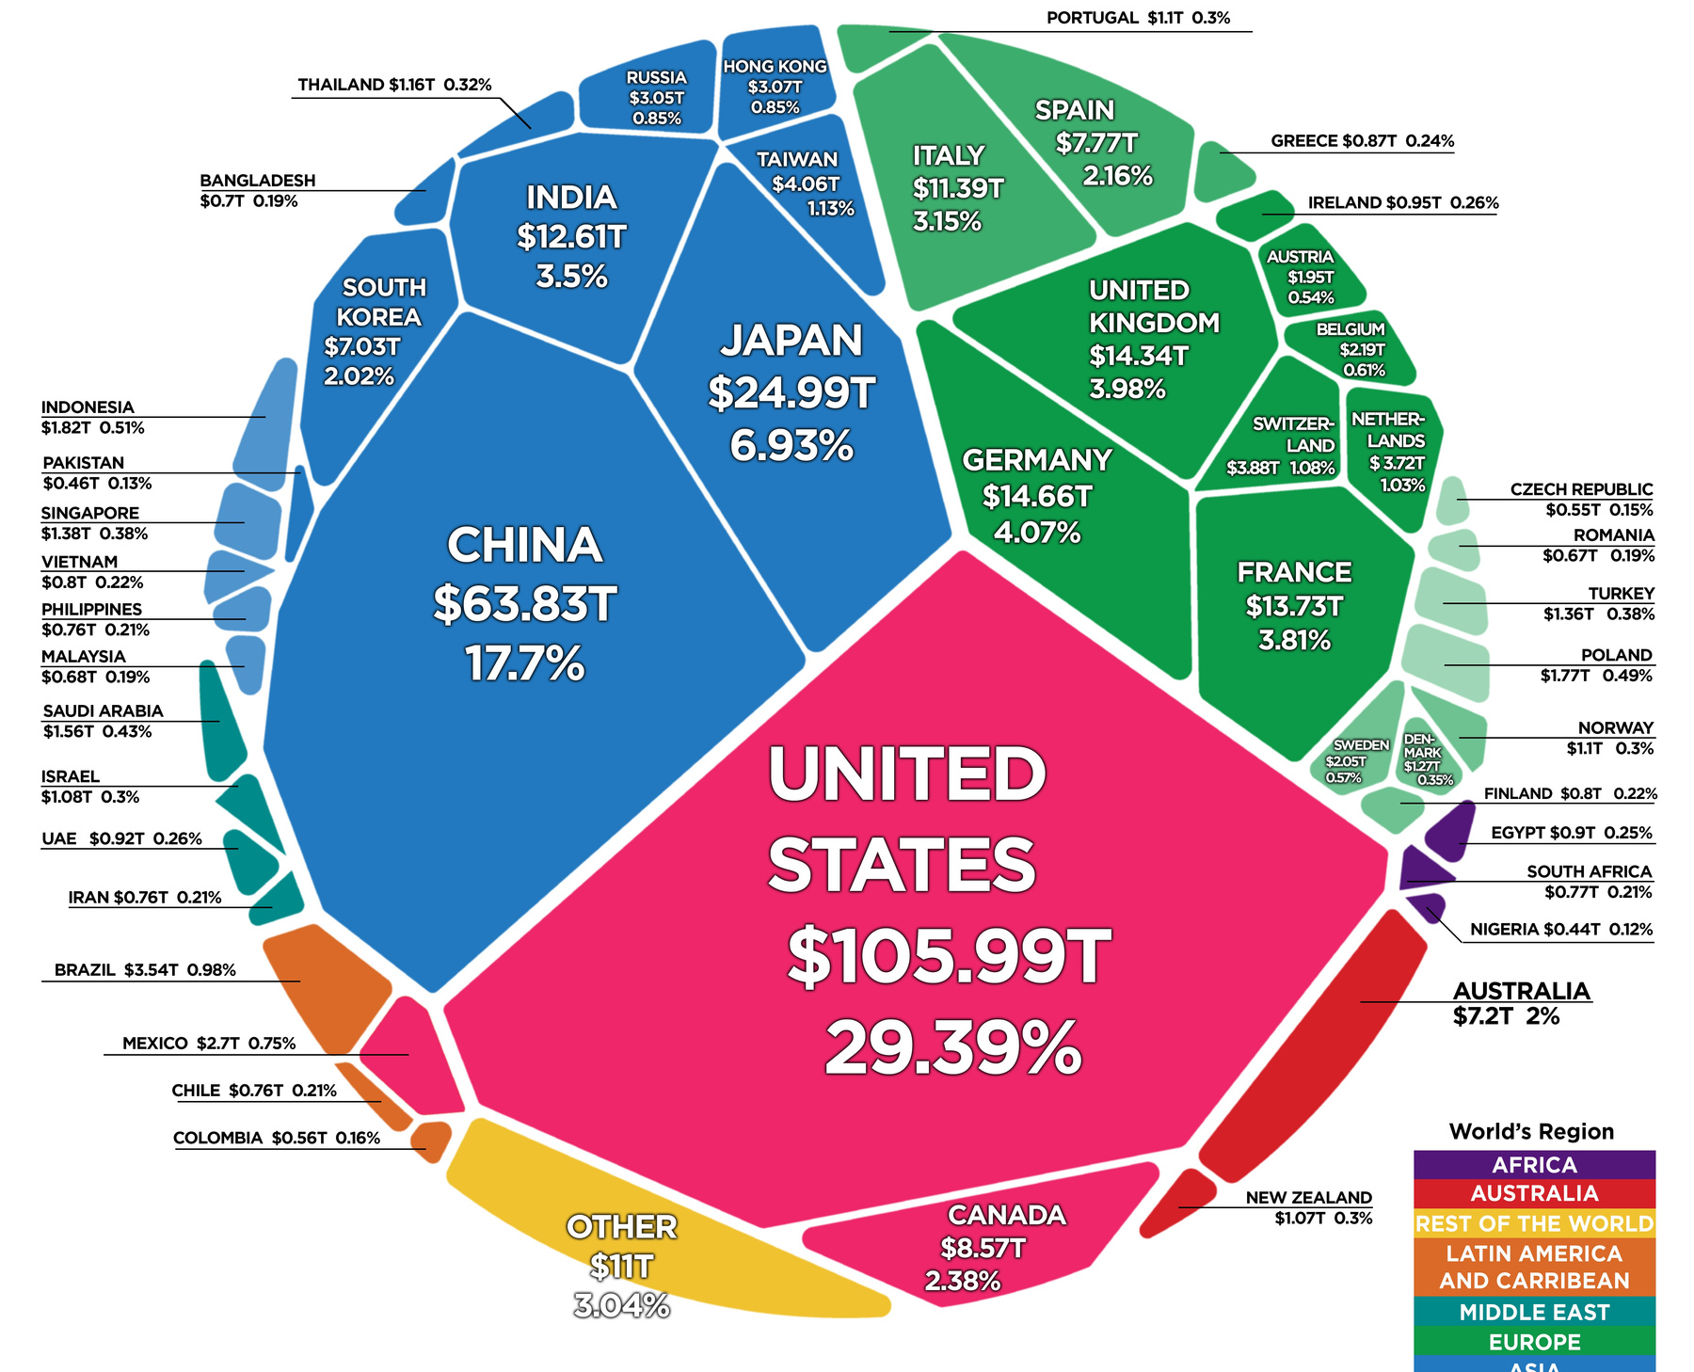
WEALTH DISTRIBUTION
High-income countries, often found in North America, Western Europe, and parts of Asia, typically have the highest average wealth per capita.
Countries in regions like Asia, Latin America, and parts of Eastern Europe are considered emerging economies.
Many countries in Africa, parts of Asia, and South America are categorized as developing countries.

Slide 5
PROJECT GOALS
Identify Wealthiest countries & their similarities
Determining Country’s economy affecting factors
Affecting factors and their linkage with countries
Q1
Q2
Q3

Slide 6
IDENTIFY WEALTHIEST COUNTRIES & THEIR SIMILARITIES
Determine which countries are the wealthiest based on various economic indicators, such as GDP per capita, average income, and wealth distribution.
Uncover commonalities among these wealthy countries, such as strong financial sectors, high human development index, and diverse industries.

Slide 7
DETERMINING COUNTRY’S ECONOMY AFFECTING FACTORS
We may identify the primary economic indicators that significantly affect a country's wealth, such as GDP growth, investment levels, and export-import ratios.
Socioeconomic factors like education, healthcare, and income equality may play a role in determining a country's economic prosperity.

Slide 8
AFFECTING FACTORS AND THEIR LINKAGE WITH COUNTRIES
We will establish correlations between specific affecting factors (e.g., investment in education, political stability, technological innovation) and a country's wealth.
In-depth analysis of specific countries can provide valuable insights into how certain factors have influenced their economic development.

Slide 9
POTENTIAL CHALLENGES & RISKS
Defining and measuring wealth can be complex, as it involves various economic indicators.
So, we intend to use strong wealth metrics available in our dataset such as GDP, tax revenue, total tax rate.
Establishing causal relationships between variables can be challenging.
Correlation techniques such as Apriori algorithm may come in handy determining relationships between variables.

Slide 10
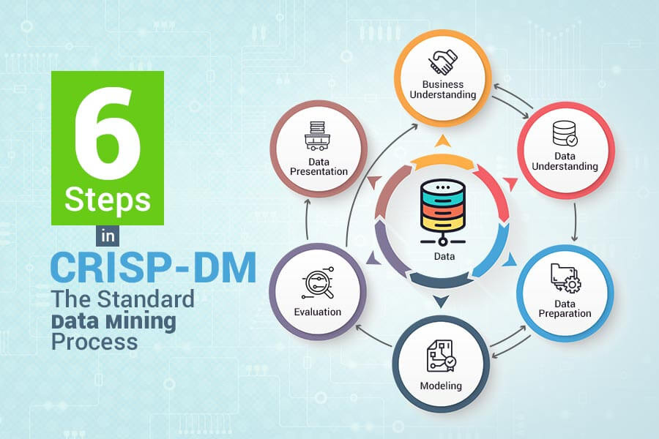
METHODOLOGIES

Slide 11
OUR TIMELINE
October 2023
November 2023
December 2023
business & Data Understanding
Data Preparation & Data Modelling
Evaluation & Deployment

Slide 12
Thank you!

